Slide 1
An Apple in Modern Eden: The Biblical and Emotional Truths About LGBT Issues April 2017
David H. Pickup, MA, LMFT
Dallas, Texas…Los Angeles, California

Slide 2
True or False?
1. Homosexual/Transgender feelings are a choice.
2. Gay marriage is about love & marriage.
3. There is a Gay gene and a Transgender gene.
4. The highest at risk group for disease is age 18-25.
5. Safe sex prevents diseases.
6. Homosexual Christians were in the early church.
7. LGBT persons are mentally ill.
8. Temptations are sinful.
9. Repentant homosexuals are fully accepted in the church.
10. Transgenders are defined as intersex.

Slide 3
Scripture
1st Corinthians 6:9-11…Do you not know that the wicked will not inherit the kingdom of God? Do not be deceived: Neither the sexually immoral nor idolaters nor adulterers nor male prostitutes nor homosexual offenders nor thieves nor the greedy nor drunkards nor slanderers nor swindlers will inherit the kingdom of God. And that is what some of you were. But you were washed, you were sanctified, you were justified in the name of the Lord Jesus Christ and by the Spirit of our God.
Romans 1:25-27…They exchanged the truth of God for a lie, and worshiped and served created things rather than the Creator-- who is forever praised. Amen. Because of this, God gave them over to shameful lusts. Even their women exchanged natural relations for unnatural ones. In the same way the men also abandoned natural relations with women and were inflamed with lust for one another. Men committed indecent acts with other men, and received in themselves the due penalty for their perversion.
What’s the LGBT answer to these scriptures?

Slide 4
The Basics – 3 Causes
Severe Gender Inferiority or Dysphoria
Severely Unmet Needs…
Affirmation, Approval, Affection
Early relationship insecurity
3. Sexual Abuse

Slide 5
Sexual Abuse
Yes…It happens
50%-75% of Gay men are sexually abused
Yes, It happens…even within the Church
1 in every 4 girls…1 in every 7 boys

Slide 6
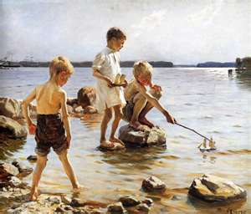
What’s supposed to happen

Slide 7
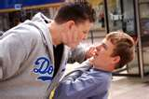
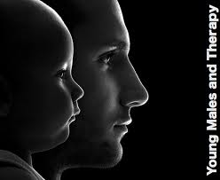
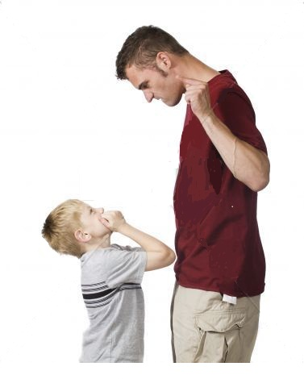
Gender Identity Inferiority…Unmet Needs

Slide 8
Understanding the Root Causes of Homosexuality
Growing
Male
Identity
Loss of father & Three A’s
Overly tied to Mother
Shamed Male Self
Peer Shame/Bullying
Emotional Abandonment
Pain
Defense Mechanisms
Shame-based St.’s
Def. Detachment
Disowned parts,
“Happy” (False) Self
Resulting SSA
T

Slide 9
LGBT Issues are Overtaking our
Country & Churches: What Do We Do?
Approximately 2.5% of Americans identify as homosexual
Where did the LGBT movement come from?
1972…DSM II
AIDS in the 80’s
1960s, Movies, TV, Internet, Universities, high schools, Wealthy advocates, elected officials, the President, judges & American denial
Who’s next? What’s next?
The homosexual agenda contains only a 3 tier foundation:
1. Born that way theory 2. It’s all about love 3. Civil rights.

Slide 10
In their own words: Ted

Slide 11
In their own words

Slide 12
In their own words

Slide 13
In their own words

Slide 14
In their own words

Slide 15
How Do We Help the LGBT Struggler?
You’re going to…
…Have to talk about it…Reality, scripture, love.
…Demonstrate compassion.
…Learn how shame creates homosexual feelings.
…Educate church members and your family.
…Offer need fulfillment to the needy.
…Get them help, therapy, groups, etc.
…Be a part of their lives…mentorship
If you don’t, other men & women WILL.

Slide 16
Understanding the Root Causes of Homosexuality
Growing
Male
Identity
BOYHOOD Growing Male Identity
(Heterosexuality)
Loss of father & Three A’s
Overly tied to Mother
Shamed Male Self
Peer Shame/Bullying
Emotional Abandonment
Pain
Defense Mechanisms
Shame-based St.’s
Def. Detachment
Disowned parts,
“Happy” (False) Self
Resulting SSA
Shamed Self into A-Self
T
Healthy Male Self-esteem
Natural Dissipation of H.
GRIEF
A
Close-knit Male Friends
Attractions for Women

Slide 17
How Do We Help the LGBT Struggler?
Authentic Reparative Therapy…
…Reflects sound biblical principles
…Is not a “magic pill” and doesn’t “trump” the Word
…Works because it feels and deals with causes
…Reflects compassion (Agape)
God is in it all…He is the great Physician!
In the New Testament…Love is the answer.

Slide 18
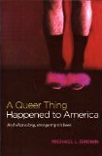
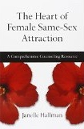
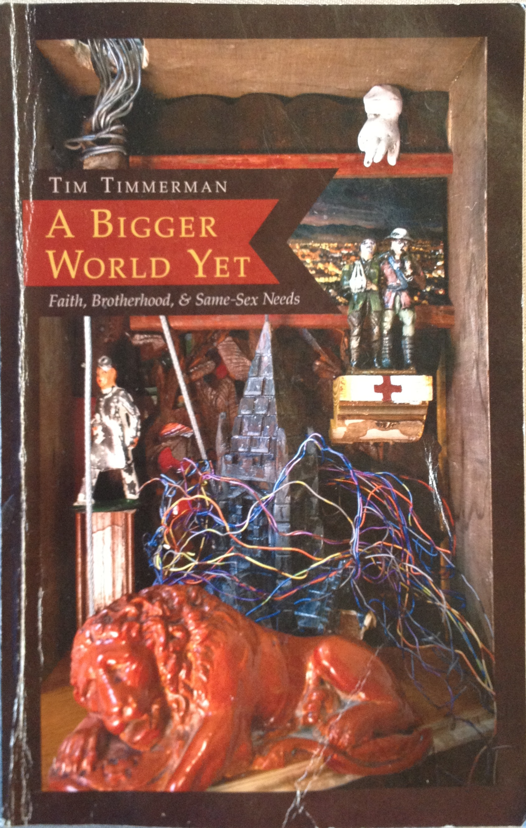
RESOURCES
www.voices-of-change.org, www.narth.com
www.ReparativeTherapyCenter.com
http://www.breakpoint.org/2017/03/breakpoint-the-silent-suffering-of-gay-men/
https://www.thegospelcoalition.org/article/two-minute-clip-homosexuality-every-christian-should-watchhttps://www.thegospelcoalition.org/article/you-are-not-your-sexuality,
https://youtu.be/ptNHDclmFSE

Slide 19
Transgenderism in Children and Adults: Traumatic Causes, The Healing Power of God, and Successful Therapy October 2015
David H. Pickup, MA, LMFT
Dallas, Texas…Los Angeles, California

Slide 20
TRUE or false?
1. Women can be genetically born in men’s bodies.
2. Transgenderism is about being true to one’s self.
3. Early trauma in gender identity can cause T.
4. Trans population at much higher risk for drugs/violence.
5. Transgenders are mentally ill.
6. Trans persons come from mentally ill families.
7. Other profound emotional issues attend T.

Slide 21
The Basics
Severe Gender Identity Dysphoria
Intense unsettling family dysfunction
Severely Unmet Needs…
Affirmation, Approval, Affection
3. Medical abuse/Media abuse/Activism

Slide 22
The research says…
75% of gender dysphoria persons resolved
by adulthood.
30% suicide rate
Johns/Hopkins and others closes transgender clinics
Current research says “We don’t know” causes http://thefederalist.com/2016/04/26/7-questions-about-transgender-people-answered/
5. DSM5 change – Gender ID Disorder to Dysphoria

Slide 23
The testimonials…
Walt Heyer –
http://www.sexchangeregret.com
http://www.thepublicdiscourse.com/2015/04/14905/
"Sex Change" Surgery: What Bruce Jenner, Diane Sawyer, and You Should Know by Walt Heyer within Culture, Sexuality, April 27th, 2015
“The dark and troubling history of the contemporary transgender movement, with its enthusiastic approval of gender-reassignment surgery, has left a trail of misery in its wake.”

Slide 24
The testimonials…
“The dark and troubling history of the contemporary transgender movement, with its enthusiastic approval of gender-reassignment surgery, has left a trail of misery in its wake.”
Bruce Jenner and Diane Sawyer could benefit from a history lesson. I know, because I suffered through “sex change” surgery and lived as a woman for eight years. The surgery fixed nothing—it only masked and exacerbated deeper psychological problems.
The beginnings of the transgender movement have gotten lost today in the push for transgender rights, acceptance, and tolerance. If more people were aware of the dark and troubled history of sex-reassignment surgery, perhaps we wouldn’t be so quick to push people toward it.
The setting for the first transgender surgeries (mostly male-to-female) was in university-based clinics, starting in the 1950s and progressing through the 1960s and the 1970s. When the researchers tallied the results and found no objective proof that it was successful—and, in fact, evidence that it was harmful—the universities stopped offering sex-reassignment surgery.
Since then, private surgeons have stepped in to take their place. Without any scrutiny or accountability for their results, their practices have grown, leaving shame, regret, and suicide in their wake.

Slide 25
The testimonials…
“The Founding Fathers” of the Transgender Movement - The transgender movement began as the brainchild of three men who shared a common bond: all three were pedophilia activists. Kinsey, Benjamin, Money, Walker in the 50’s through recent.
Dr. Kinsey experiments, Dr. Benjamin recommendations of surgery and hormones,
Dr. Money believed gender changeable in early childhood through surgery; accidents.
Dr. Walker, (Heyer’s doctor) created Walker Standard of “Care.”
Walt – “Eventually, I gathered the courage to admit that the surgery had fixed nothing—it only masked and exacerbated deeper psychological problems.The deception and lack of transparency I experienced in the 1980s still surround gender change surgery today. For the sake of others who struggle with gender dysphoria, I cannot remain silent. It is intellectually dishonest to ignore the facts that surgery never has been a medically necessary procedure for treating gender dysphoria and that taking cross-gender hormones can be harmful. Modern transgender activists, the descendants of Kinsey, Benjamin, and John Money, keep alive the practice of medically unnecessary gender-change surgery by controlling the flow of published information and by squelching research and personal stories that tell of the regret, unhappiness, and suicide experienced by those who undergo such surgery. Negative outcomes are only acknowledged as a way to blame society for its transphobia.”

Slide 26
The Greatest Testimonial
Genesis 5:2…Mark 10:6
“…from the beginning of creation, God made them male and female.”
Truth & Compassion works!
Compassion is not compassion without Truth
ALWAYS emotional disturbance within the parental and child relationship…intense insecurity, and dissociation to compensate. For example...

Slide 27
The Greatest Testimonial
Truth & Compassion works!
Compassion is not compassion without Truth
Spiritual compassion, walking with a struggler without judgmentalism.
Intense professional therapy…knowing how to reveal the emotional abandonment/dissassociation...reset of family structure, also complementary to God’s desgin...Joy to experience wholeness of bio gender.

Slide 28
Stand up in Society
For your children
For your children’s children
By revealing biblical truth, the research, the false evidence and compassionate relationships and therapy that works.
Most school boards, lay persons and many professionals do NOT know the evidence!

Slide 29
RESOURCES
voices-of-change.org
narth.com
ReparativeTherapyCenter.com
sexchangeregret.com

Slide 30
Friday March 31, 7:30 PM
An Apple in Modern Eden: The Biblical and Emotional Truths About LGBT Issues
Saturday, April 1, 9:00 – 9:50 AM
The Wave of LGBT Issues has Overtaken our Country and our Churches: What Do We Do?
Saturday, April 1, 10:00 - 10:50 AM
How Do We Help the LGBT Struggler?
Sunday, April 2, 10:30 AM
Causes of LGBT Issues: Spiritual and Emotional Underpinnings
Sunday, April 2, 5:00 PM
How Parents Can Prevent LGBT Issues in their Children & How Can the Church Minister to Strugglers

